Slide 1
VETERAN FACING SERVICES – DIGITAL HEALTH MODERNIZATION
1095-B Initial Research Discovery
04 February 2022

Slide 2
Agenda
01
We heard you
02
User flow & wayfinding considerations
03
Medium fidelity landing page
04
Next steps
02-04 Design Review
Agenda

Slide 3
We heard you
1095-B DESIGN REVIEW
02-04 Design Review

Slide 4
COMPARATIVE RESEARCH
From Tuesday, Feb 2
Comments | Stakeholder | Design team comments
User flow: Can we proof out VA letters? | Tracey Mulrooney | Further proofing to be discussed today
User flow: If under Health care / Manage resources, would it live on the Affordable Care Act page? | Tracey Mulrooney | Further proofing to be discussed today
User flow: How far in the navigation should this be nestled and why? | Tracey Mulrooney | Further proofing to be discussed today
Comparative: The label “Tax forms” is really clear. Are there other tax documents that could warrant a wholistic section? | Tracey Mulrooney | Confirmed via Tracey, there are no other tax forms a Veteran would receive at this time. This is a one-off use case.
Low fidelity sketch: Make contact info relevant to the form since general VA contact info is in the footer | Tracey Mulrooney | Done
Notifications: Since a 1095-B isn’t needed when submitting taxes, it would be confusing to give it too much prominence–especially on the homepage | Tracey Mulrooney | Noted
Research: For the first session, prioritize the landing page, secondarily, the wayfinding | Tracey Mulrooney | Noted priorities; we will conduct the sessions with those considerations. Given the content we should have time to address both areas and would like the opportunity to validate both needs, twice.
02-04 Design Review
Comparative Research

Slide 5
COMPARATIVE RESEARCH: KEY EXPERIENCE TAKEAWAYS
Informed, focused design
As takeaways, we identified three areas of focus for this project:
Seamless User Experience – the form should be easily findable through the navigation, leveraging plain language, and redirected to it through relevant crosslinks.
Authenticated & Unauthenticated Experiences – an unauthenticated experience, as well as personalized content through an authenticated experience, sets user expectation that there is relevant information available upon logging in, but also helps surface FAQs earlier in their journey.
Knowledge Base & Escalation Path – anticipate user issues and questions by providing contextual help and a clear path to escalate technical issues or form errors.
02-04 Design Review
Comparative Research

Slide 6
User flow
1095-B DESIGN REVIEW
02-04 Design Review

Slide 7
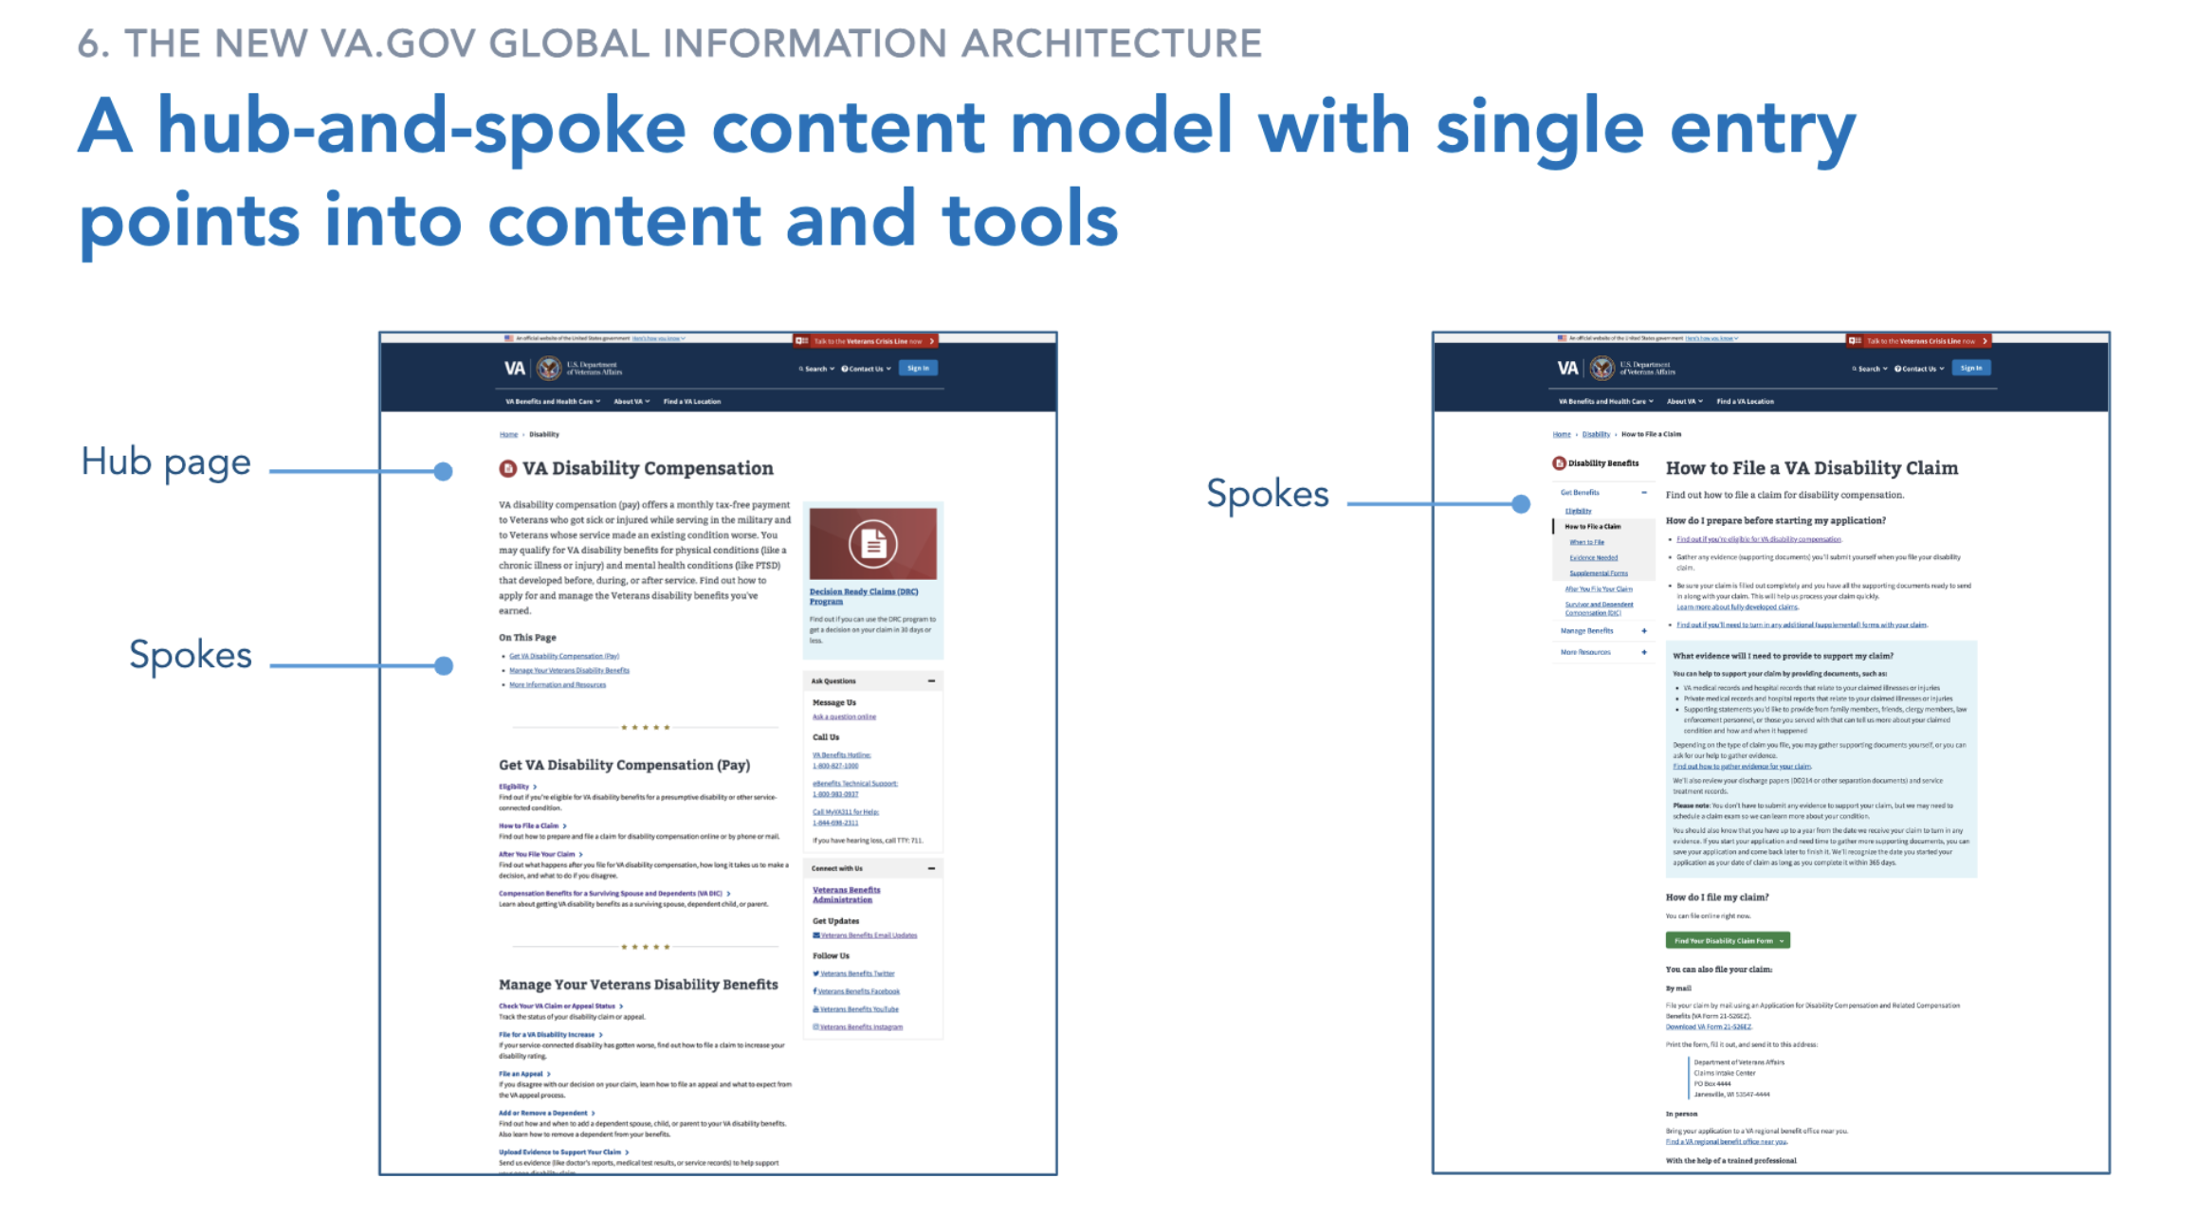
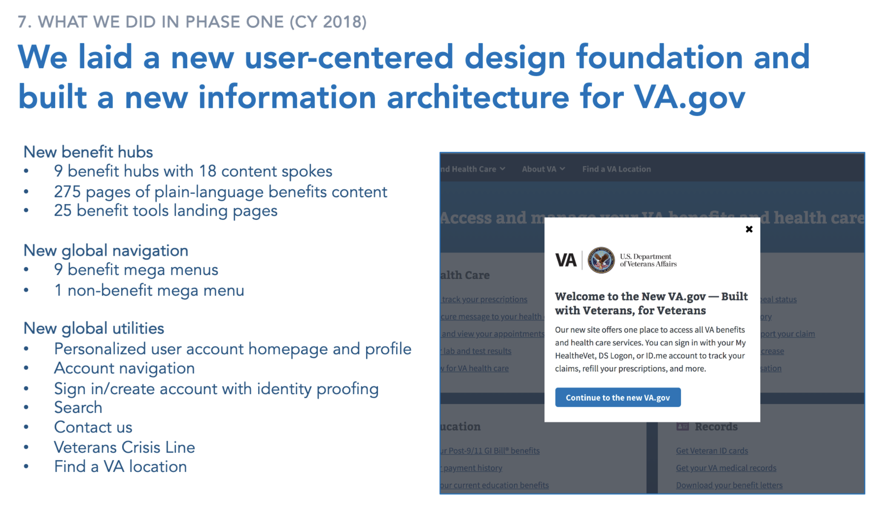
Current VA.gov IA structure
We cross-referenced the documentation around the current hub and spoke navigation. This is an effective navigation model when sites are often task based, and when users tend to visit only one hub during their session.
02-04 Design Review
User flow

Slide 8
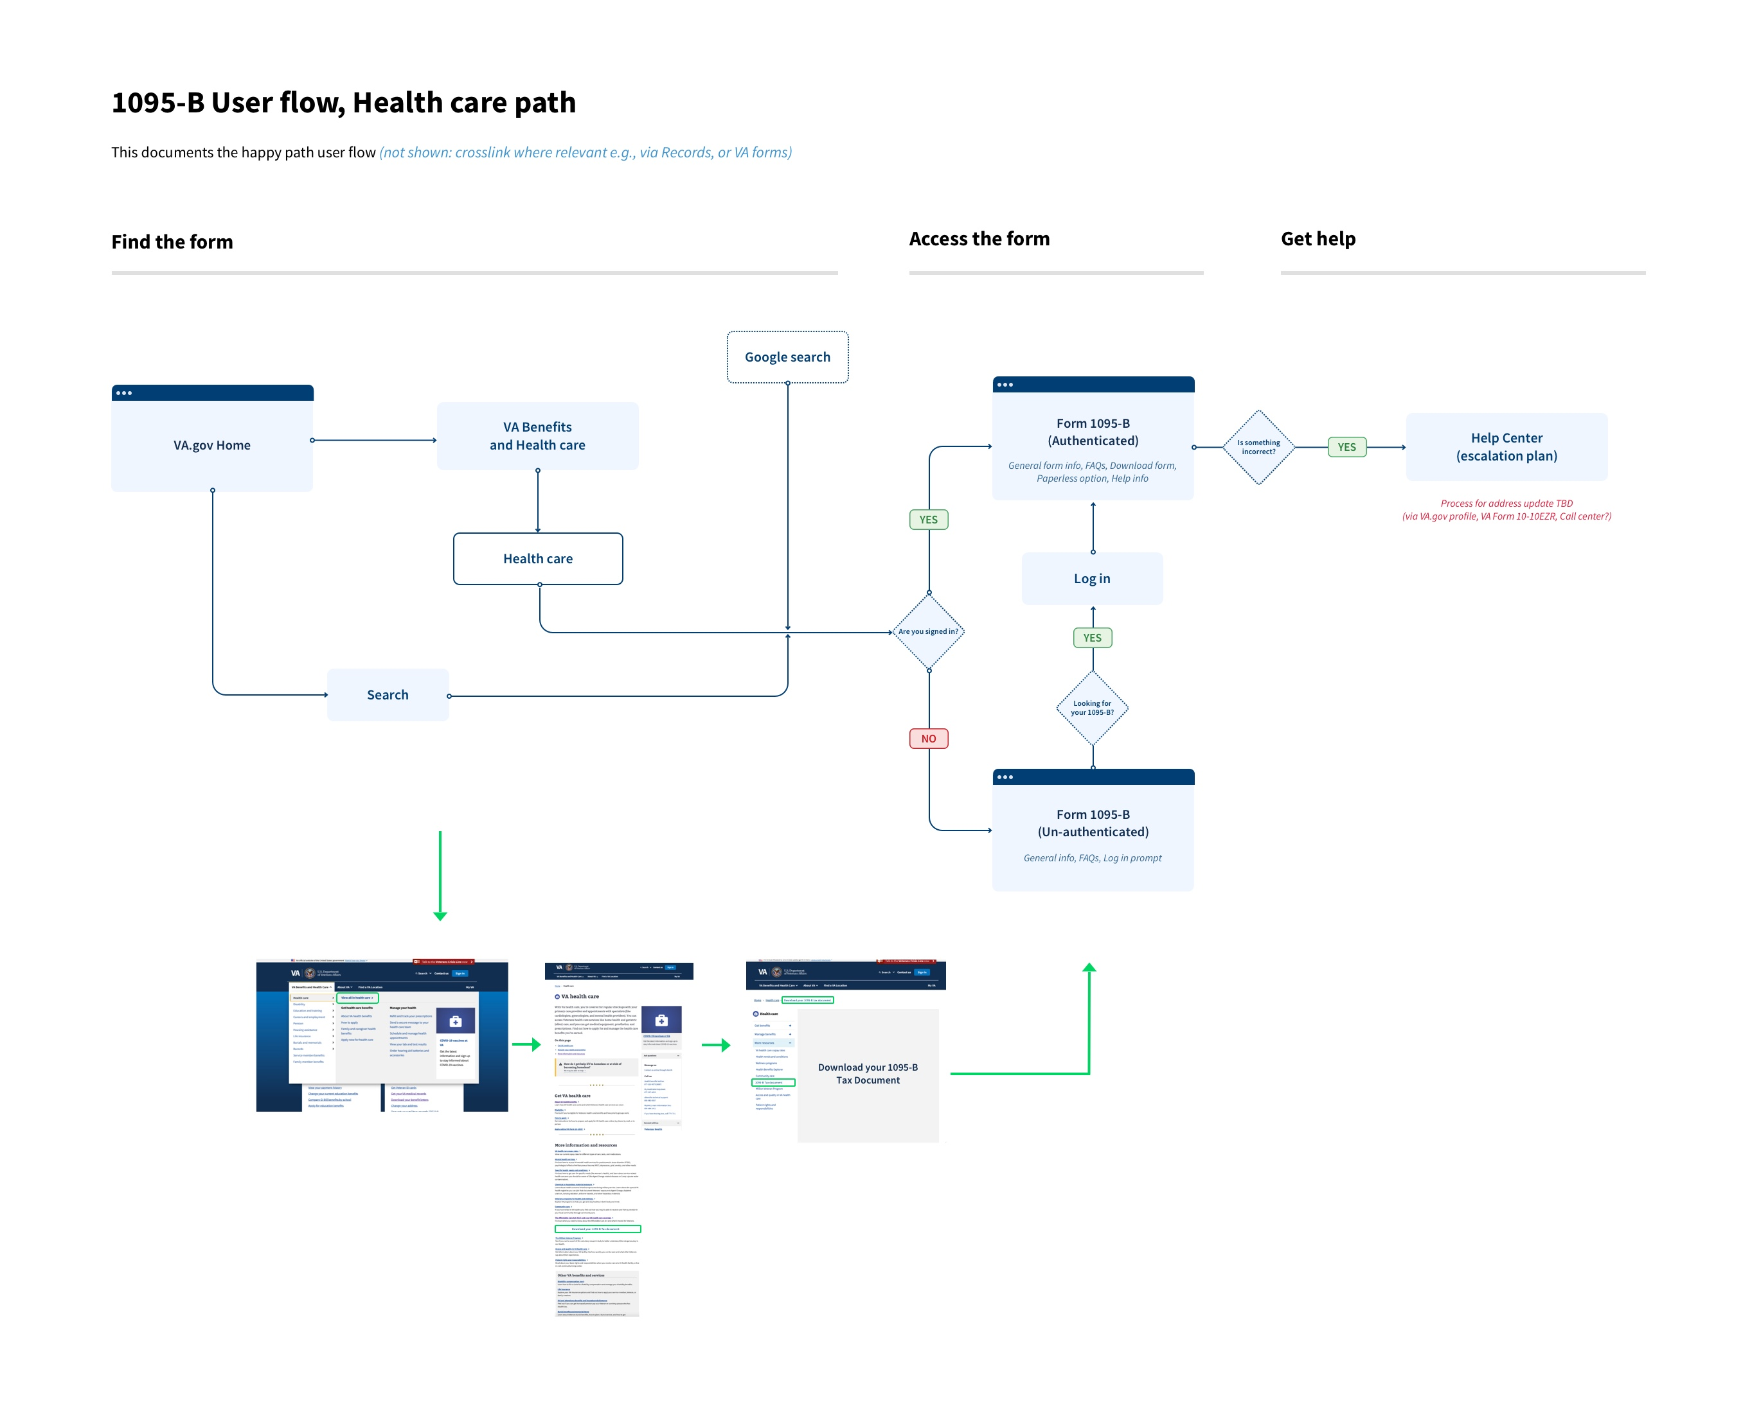
1095-B User flow, Health care path
Why this could work:
This tax document is health care specific, has a natural fit in the health benefit hub, and is directly associated the Affordable Care Act
Leverages the established hub and spoke navigation model
Risks:
Users may initially look for this document via the Records hub
How we can mitigate these risks:
Leverage a quick link in the health care megamenu during tax season
Cross link from Records section and VA forms
Further insights to be brought forward after the first round of user testing.
02-04 Design Review
User flow

Slide 9
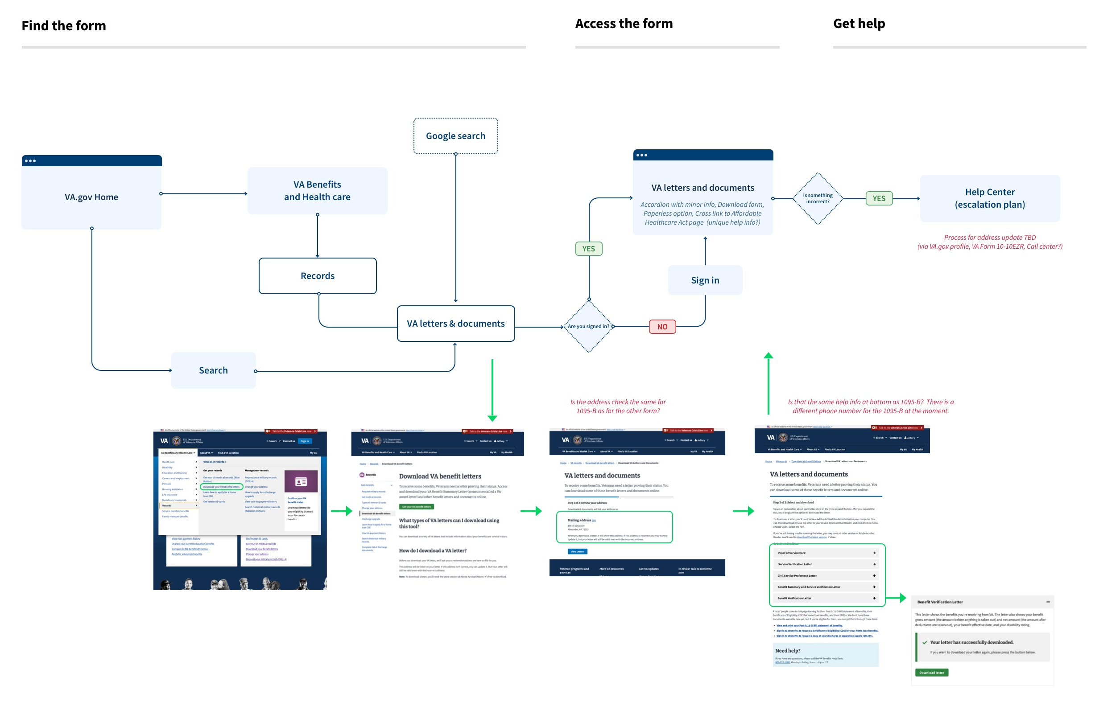
1095-B User flow, Records / VA letters path
Why this could work:
This tax document is a result of having a VA benefit (health care)
Risks:
Download VA letters is the primary nav/link label and users might be looking for the term ‘document’
The address displayed in the Download flow might not be the same as the 1095-B address (benefit system vs enrollment system)
Different help info for the 1095-B (e.g., phone number)
Does not allow for unauthenticated landing page unique to 1095-B
How we can mitigate these risks:
Leverage the Affordable Care Act page to explain more about the 1095-B and crosslink to Download VA letters & documents
Further insights to be brought forward after the first round of user testing.
02-04 Design Review
User flow

Slide 10
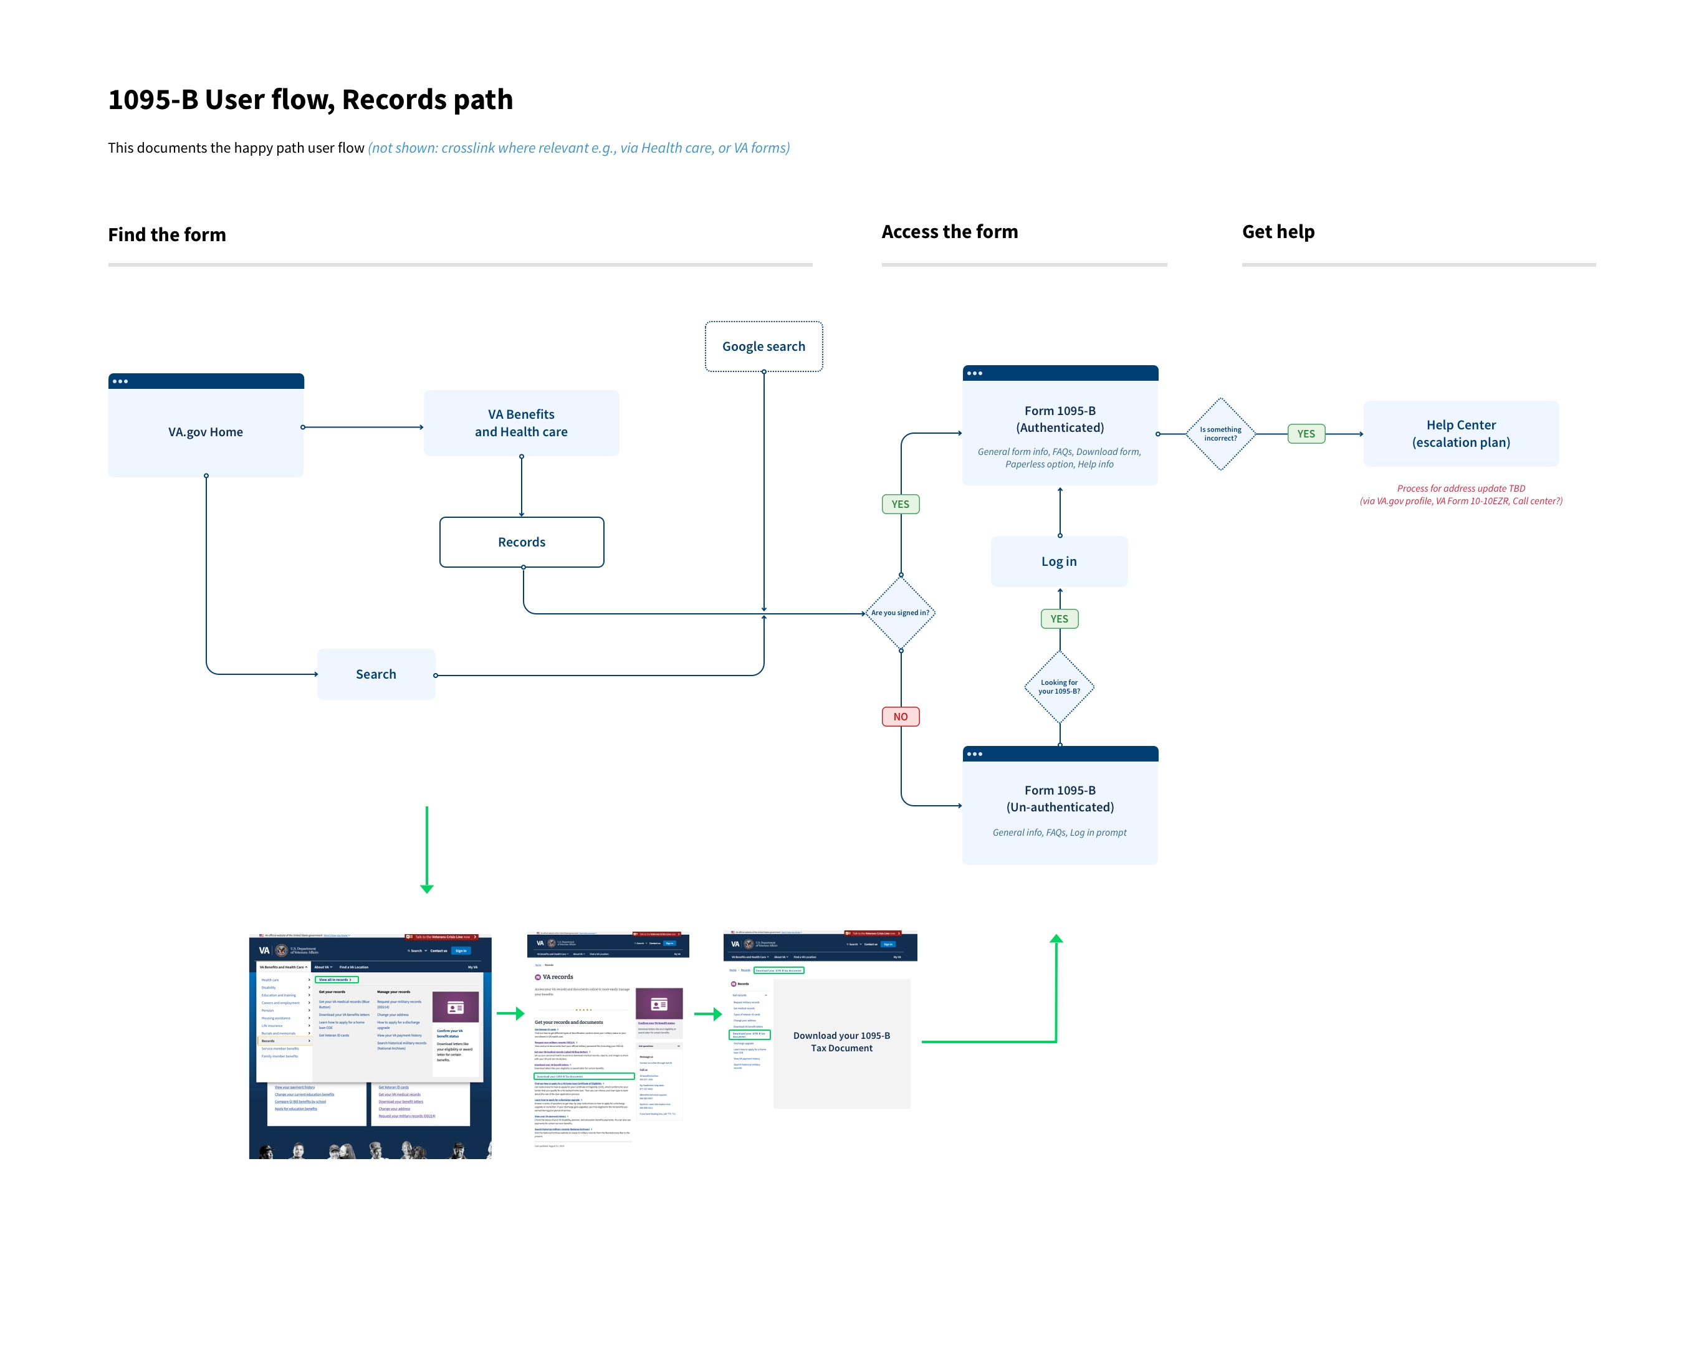
1095-B User flow, Records path
Why this could work:
This tax document is a record (proof) of your health care benefit
Risks:
Users may first enter the health care benefit hub given that the 1095-B is related to the VA health benefit (Health care is also the first hub listed in the navigation)
How we can mitigate these risks:
Crosslink to the tax document via the Affordable Care Act page
Further insights to be brought forward after the first round of user testing.
02-04 Design Review
User flow

Slide 11
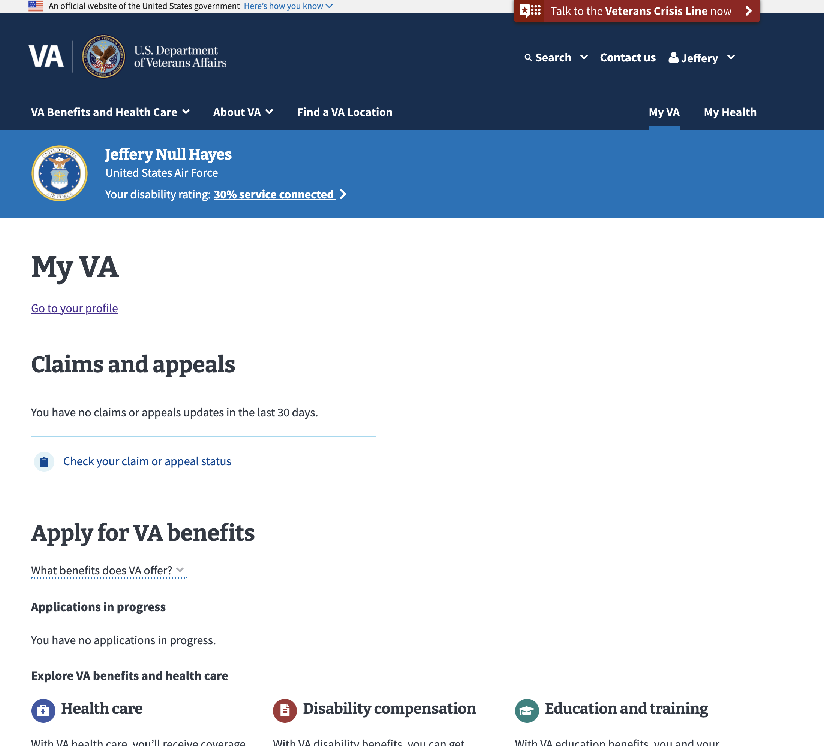
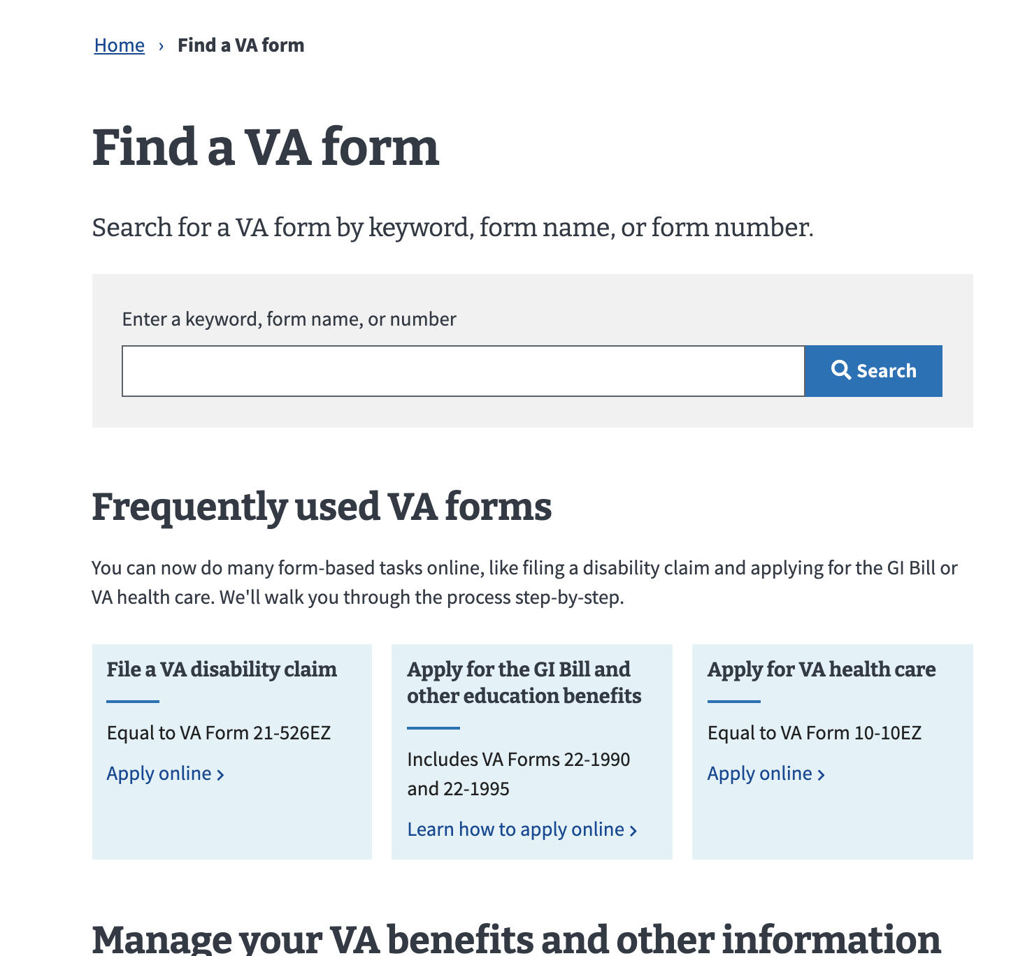
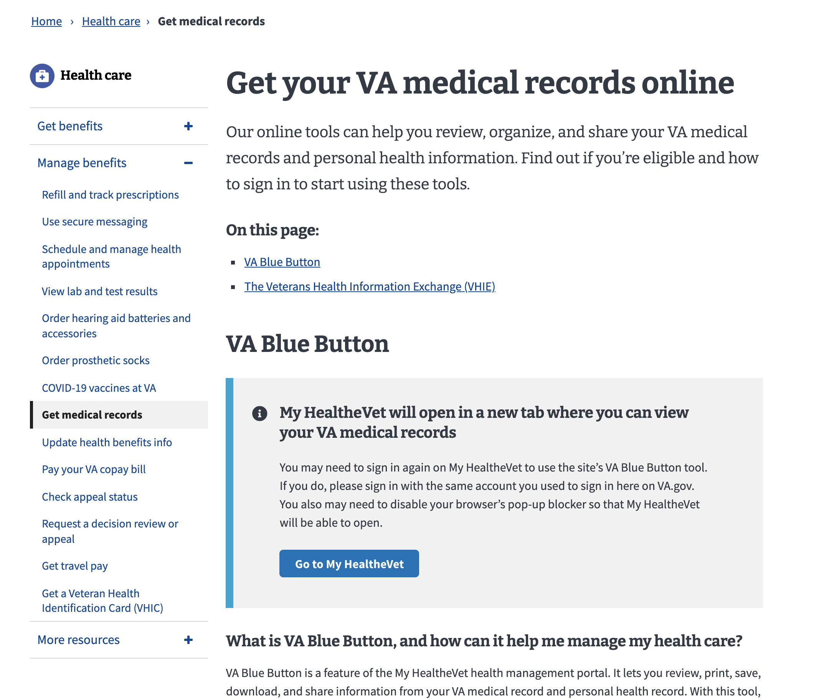
For reference, other paths we considered
Path: Tax Document hub
Not enough content to fulfill the hub and spoke navigation model, there are no other tax forms that Veterans receive regarding their benefits at this time
Alternate options provide the same speed to access for the task without larger global nav considerations
Gives hierarchical prominence to the 1095-B, the only tax form that a veteran doesn’t need to do anything with and is only relevant for reference during a tax season
Path: VA Forms
Currently this is for all forms that a Veteran can download and fill out (not pre-filled documents)
Opportunity to provide a link or prompt for users if they try to search for the 1095-B document
Path: My VA / My health
No clear placement (currently ‘application’ focused or health portal link)
No clear path to unauthenticated 1095-B content and doesn’t allow for a clear navigational path
Path: VA Blue Button
Health portal focused on health care data
No clear path to unauthenticated 1095-B content and doesn’t allow for a clear navigational path
02-04 Design Review
User flow

Slide 12
Our recommendation for testing
See full user flows here
1.
2.
02-04 Design Review
User flow

Slide 13
Landing page 1095-B
1095-B DESIGN REVIEW
02-04 Design Review

Slide 14
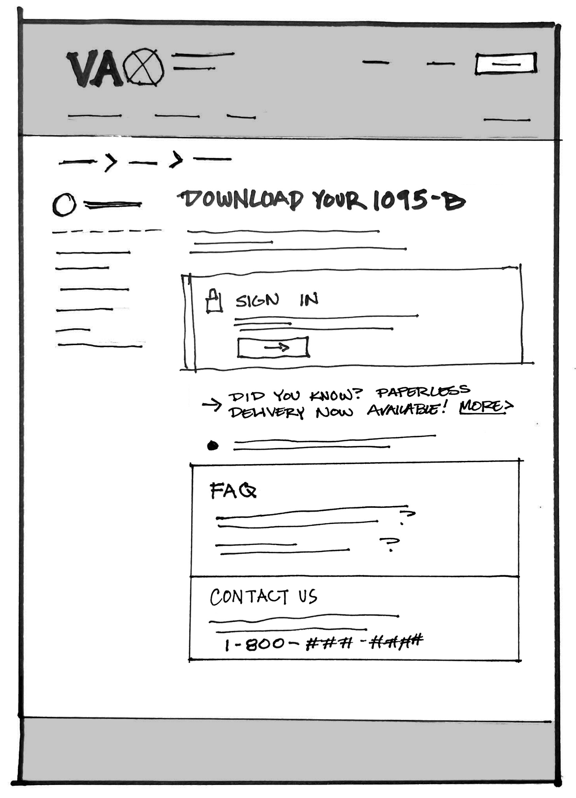
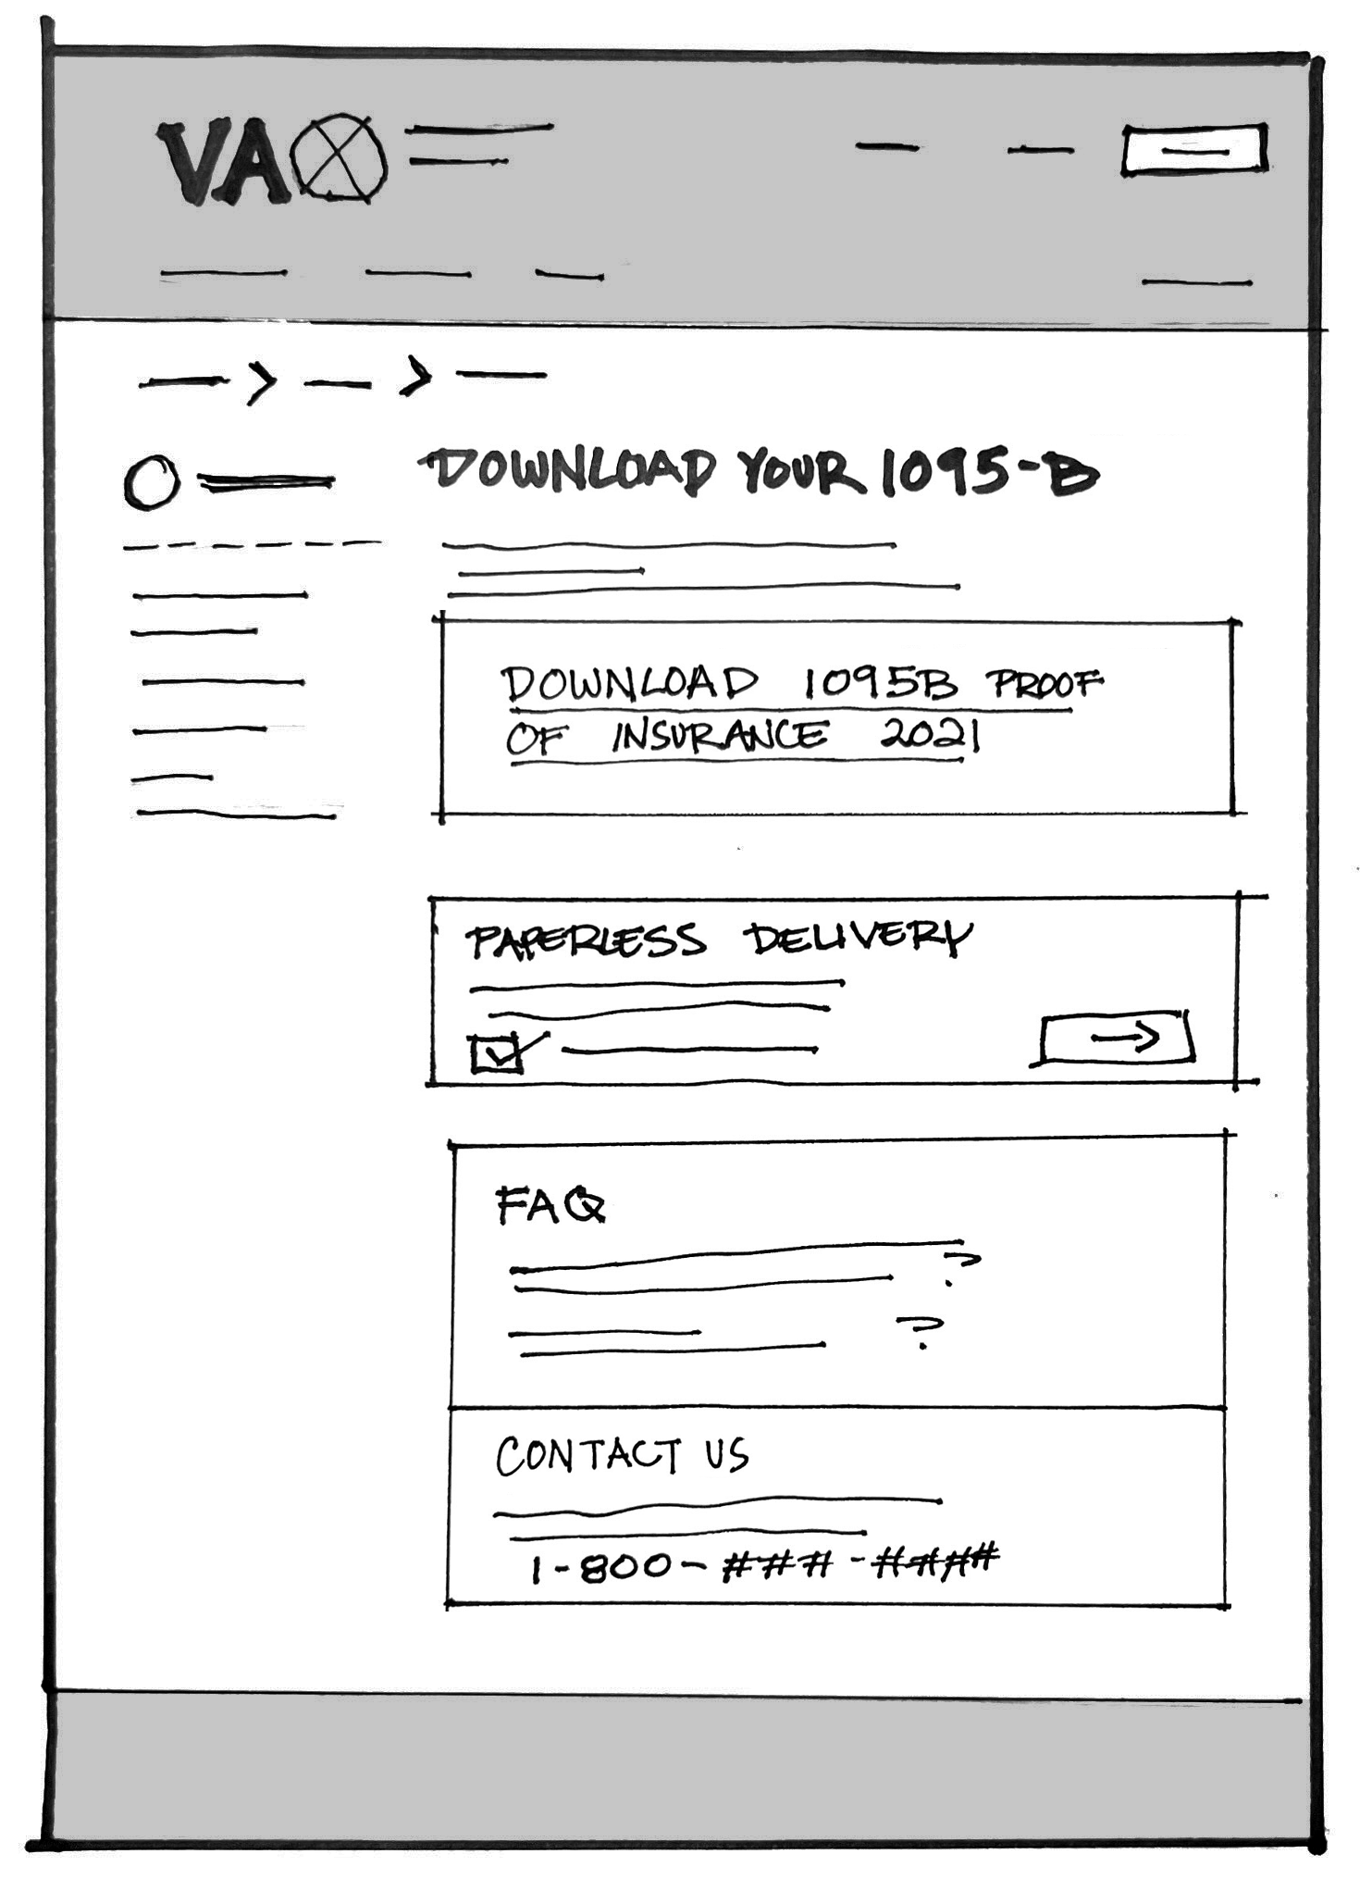
Concept sketches from Tuesday
Unauthenticated (default)
Authenticated
Sketch File Here
02-04 Design Review
Comparative Research

Slide 15
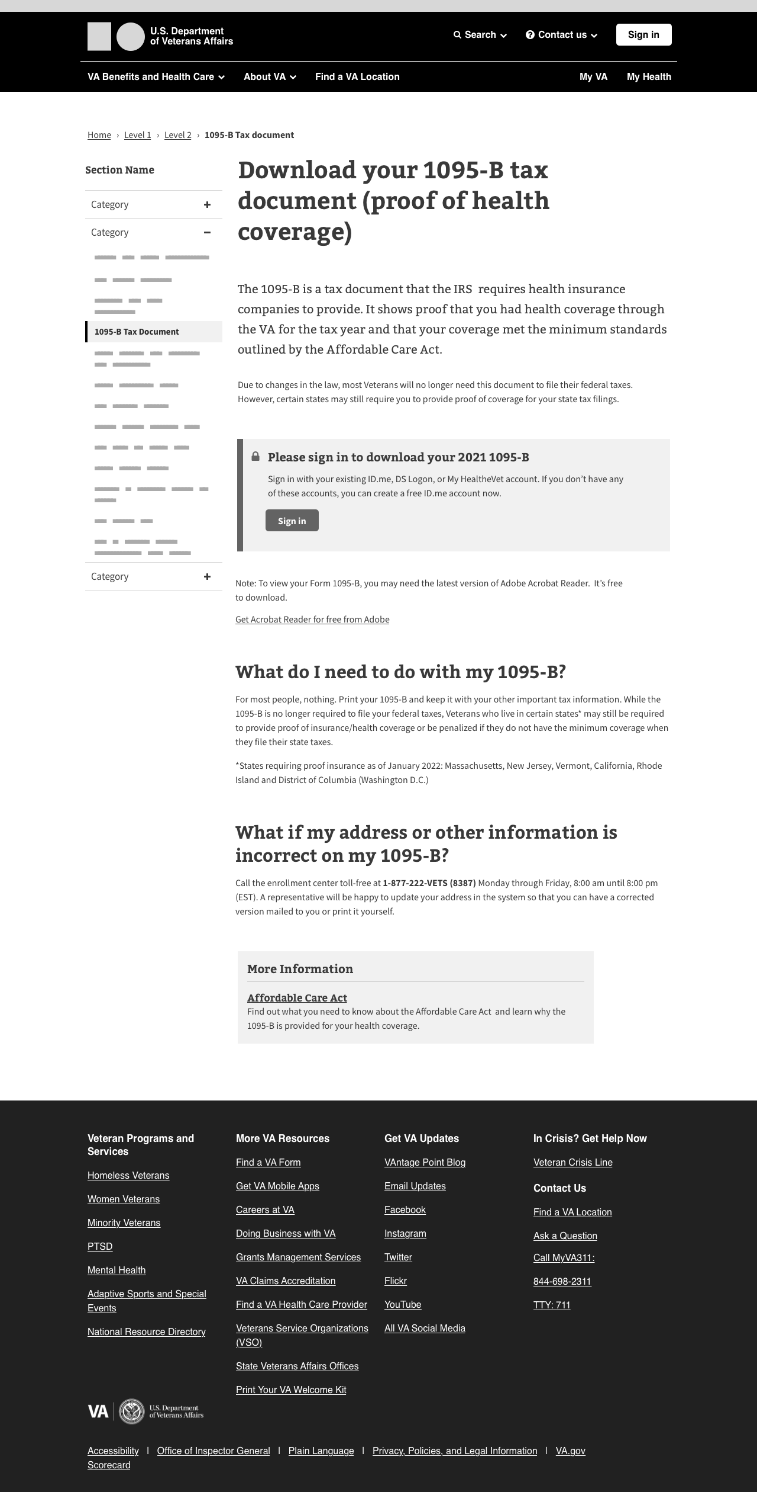
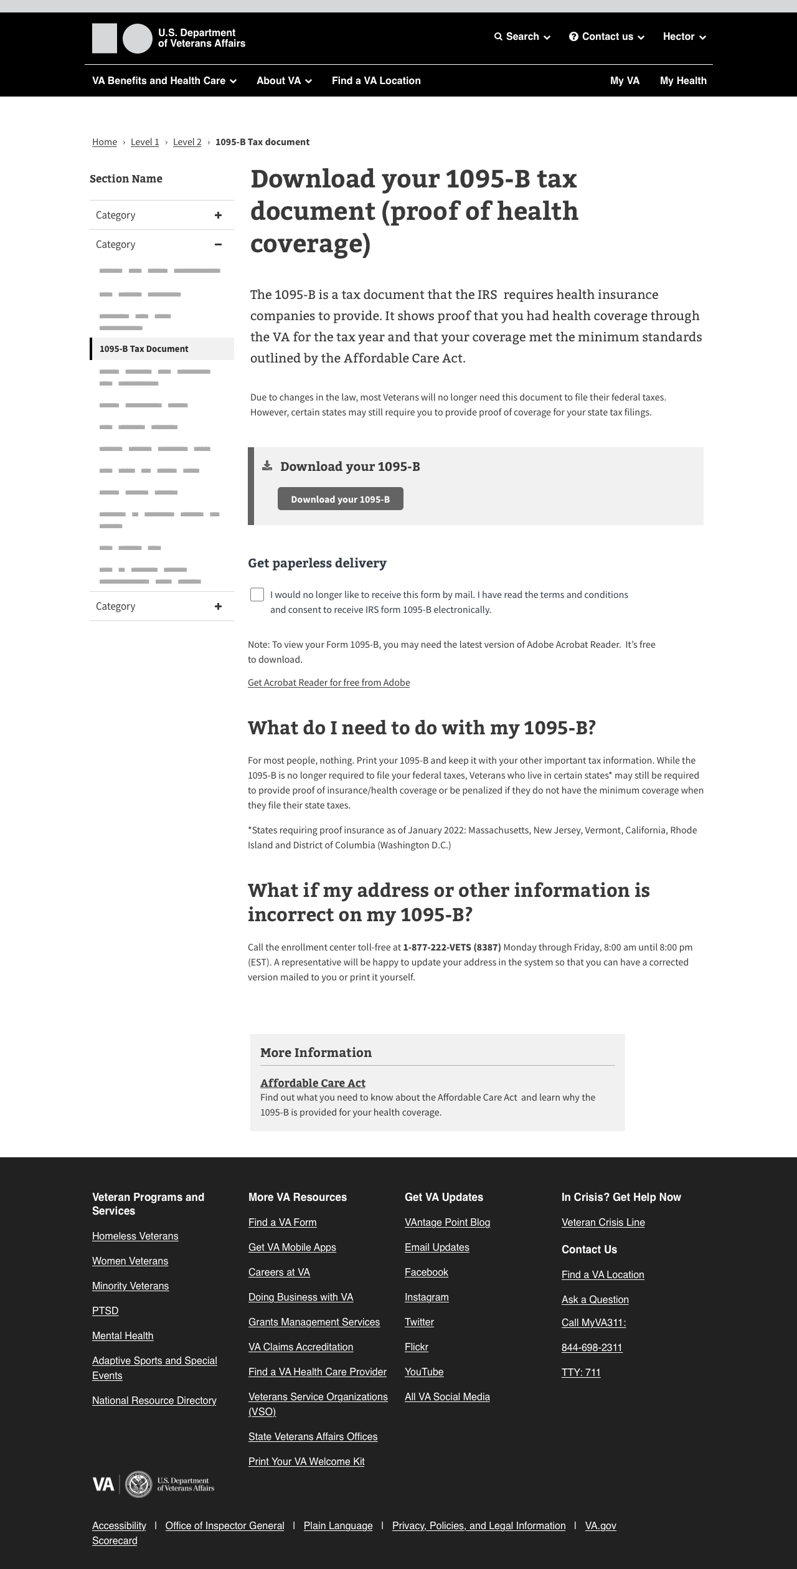
Medium fidelity designs
Unauthenticated (default)
Authenticated
Sketch File Here
02-04 Design Review
Comparative Research

Slide 16
Next steps
1095-B DESIGN REVIEW
02-04 Design Review

Slide 17
Next steps
Iterate on our discussion today
Ready content for Design Intent Sync (Monday, Feb 7, 3:30pm ET)
Submit Research Plan and schedule a sync with the Research team, goal to begin user testing Friday, Feb 11
Incorporate additional findings from Tech Discovery
Outline additional crosslink needs for users and iterate on copy
02-04 Design Review
Research Plan

